Slide 1

School of AI Health 2019 Hackathon Scan for Health

Slide 2
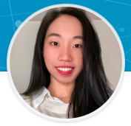
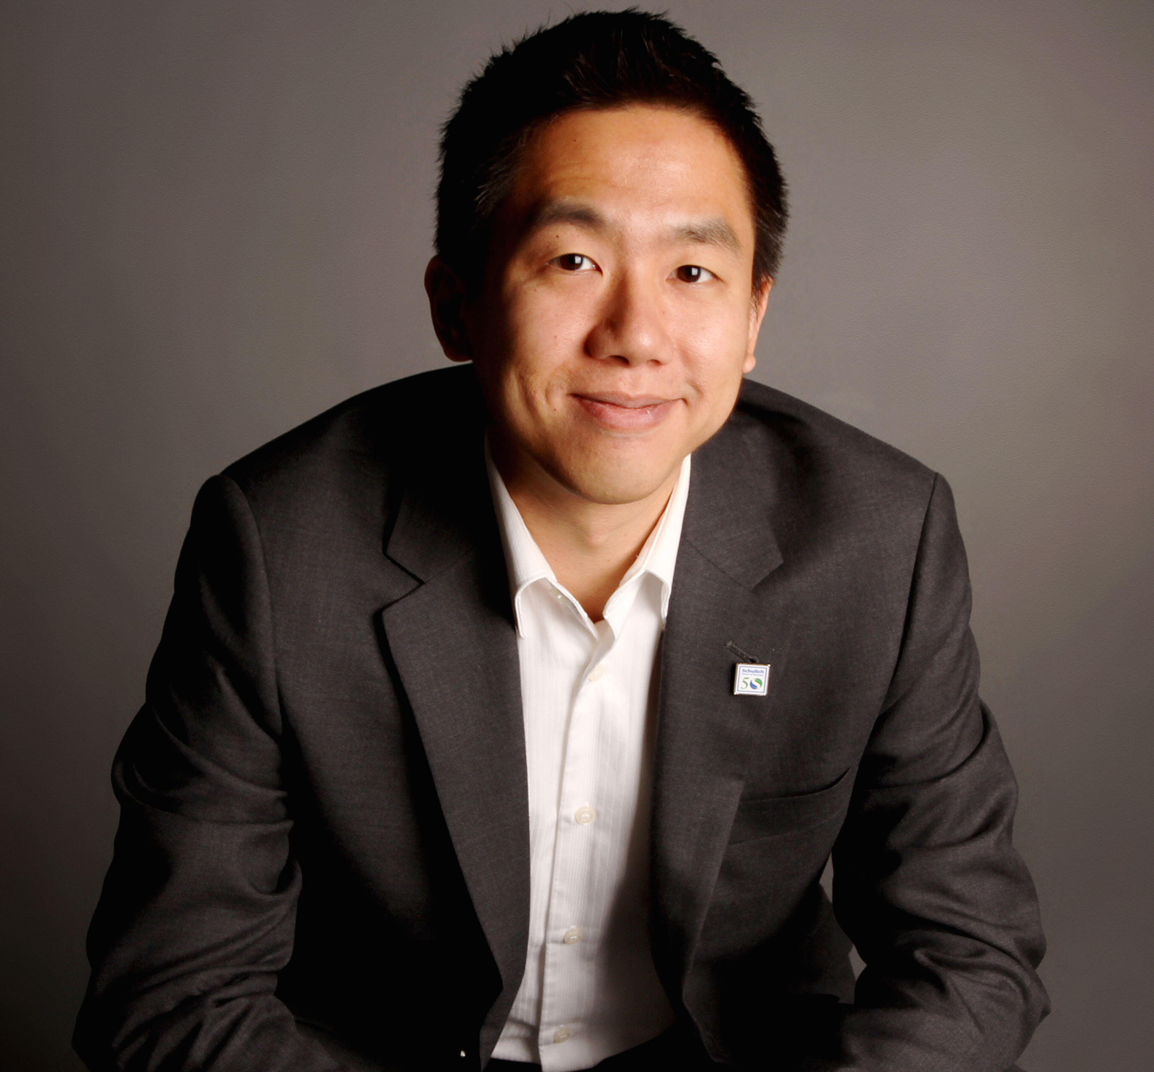
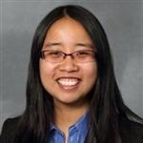
Team scan
Sally Mei
UX Designer, Researcher, and Health Information Management Professional
Yuting Chu
BCom, MBA, CSPO
India, Nunavut, BC, Nova Scotia, Ontario, Quebec
Utilities, Non Profit, For Profit, Government, Canadian Military, Private
https://yuting-chu.com/
Jessica Wu
Accenture
Applied Intelligence

Slide 3


If your hat isn’t so big that people are making fun of you, it’s probably not adequate sun protection.
Chris miller, MD
Assistant professor of dermatology
University of Pennsylvania

Slide 4
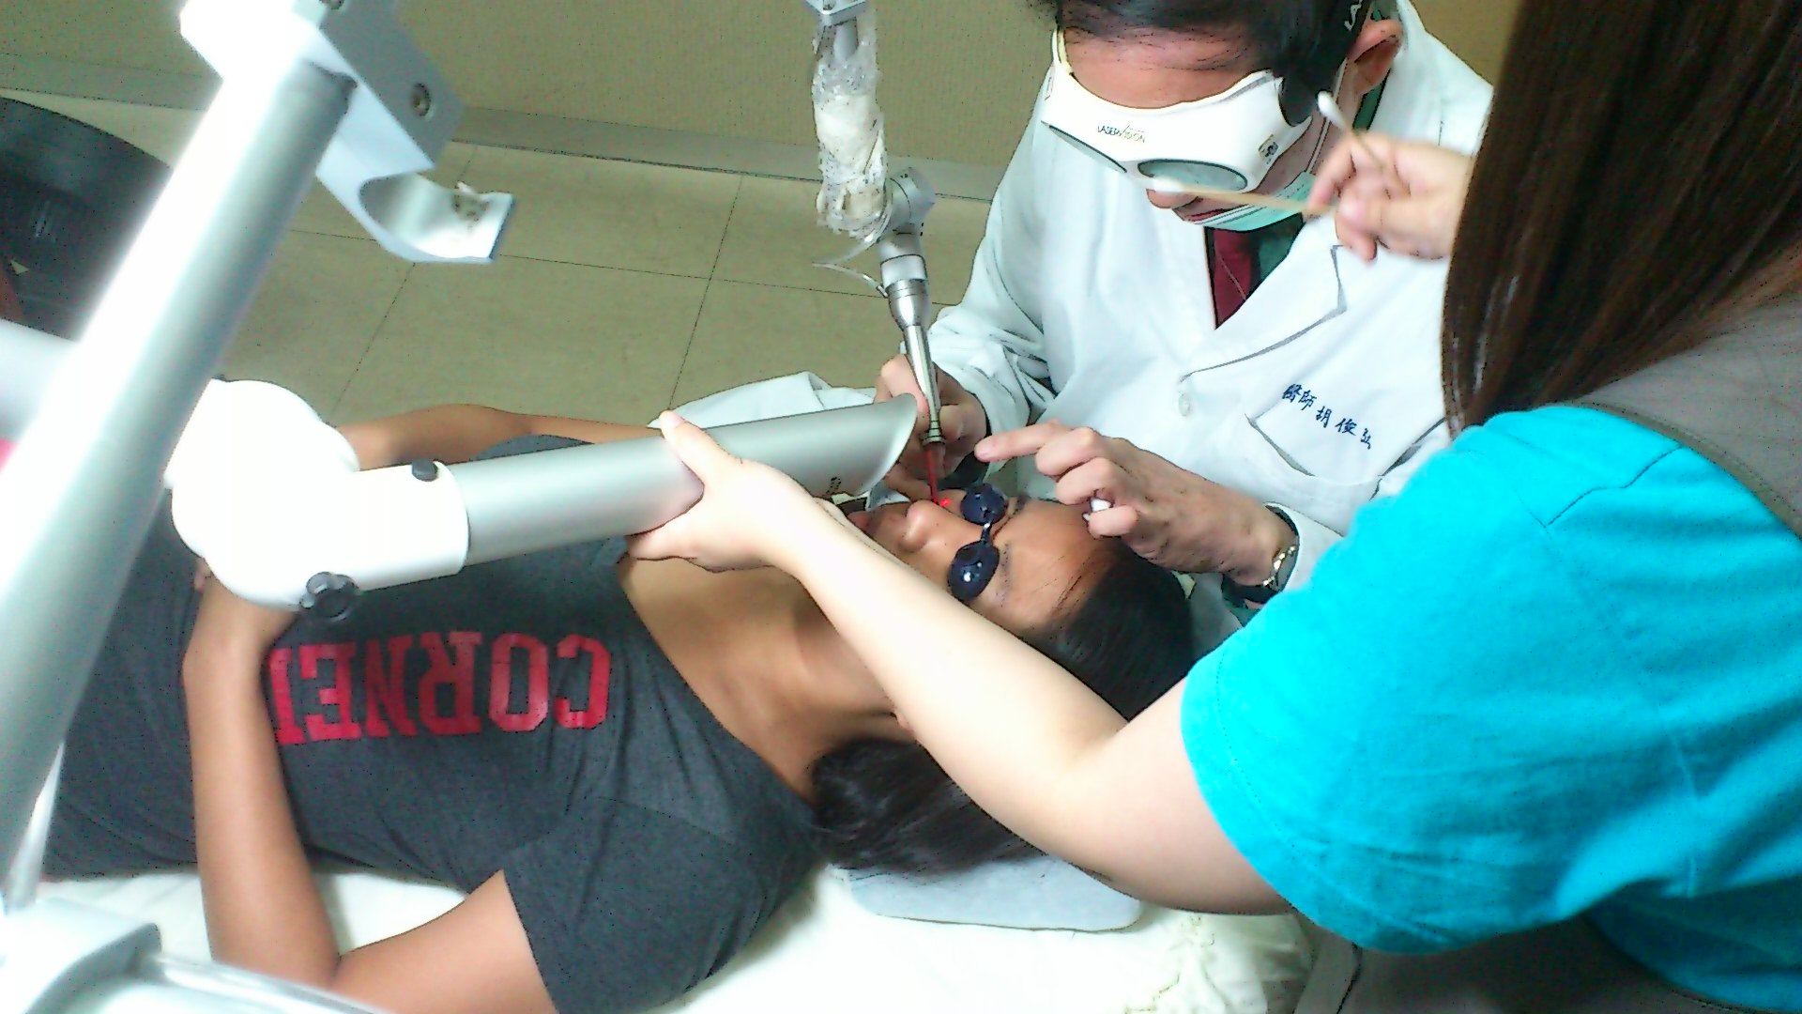
About 25% of melanoma cases develop from moles

Slide 5
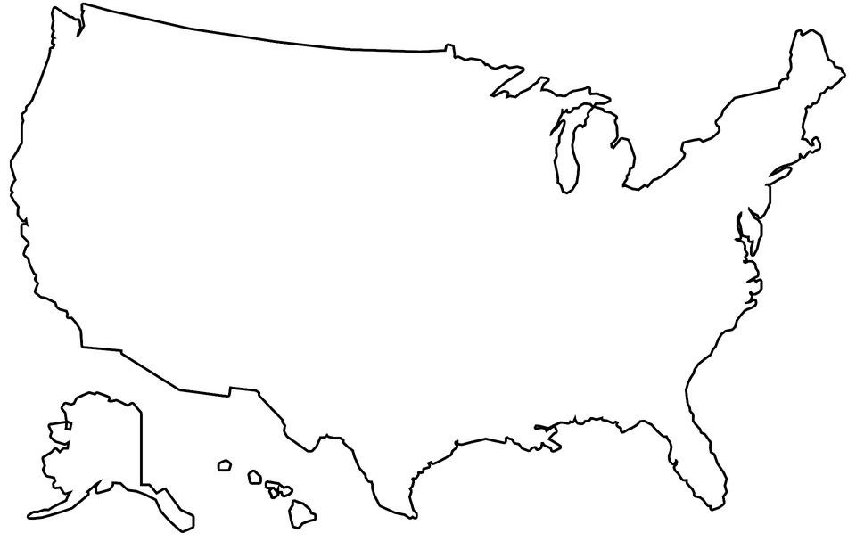

90,000 cases of melanoma diagnosed in the US every year
Notes:
How do we increase scan cancer detection in the general population?

Slide 6

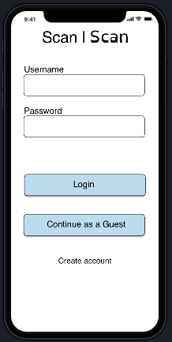
SCan | Skin Cancer Scan
Establish healthy skin habits
Raise awareness
Provide skin health recommendations
Connect to healthcare providers post scan
Targeted Users
Fair skinned | Outdoorsy | Tanning | Hazard Env.
Notes:
Create an app that can take pictures and provide doctor recommendations
Establish healthy habits
Raise awareness
Provide skin health recommendations
Involve H.C. providers post detection

Slide 7
https://invis.io/BHRAHCD25U3
Notes:
Create an app that can take pictures and provide doctor recommendations
Establish healthy habits
Raise awareness
Provide skin health recommendations
Involve H.C. providers post detection

Slide 8

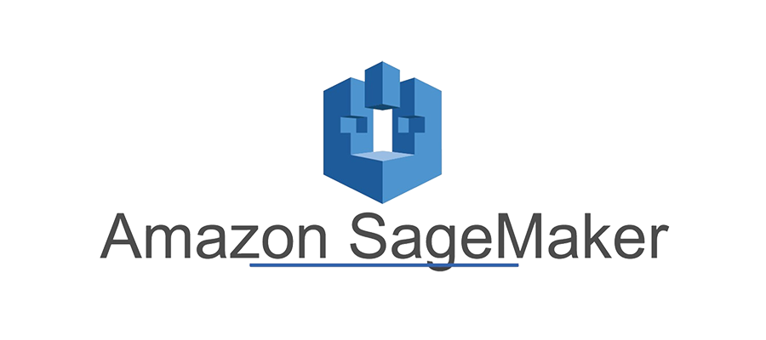


Image Storage
ML Risk Recommendation
Mobile Front End

Slide 9

Responsible AI
Health for All
+

Slide 10
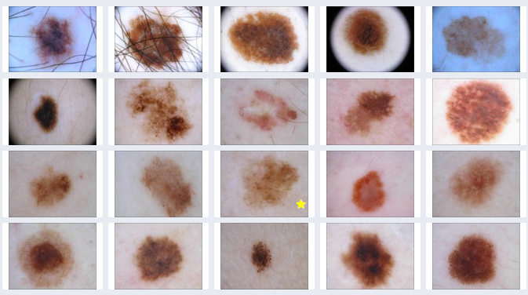
What stands out with these images?

Slide 11
Thank You!

Slide 12
financials
Cost Structure
Developers
Licensing
Servers / computing
Marketers
Sales commissions
Revenue
Advertising
Referrals
Subscriptions

